Slide 1

Asset-Based Community Development
An Overview and Framework for Discussion for Habitat for Humanity Affiliate Boards of Directors
Notes:
Hello and thank you for taking the time to participate in Habitat for Humanity International’s Asset-Based Community Development overview for Boards of Directors. As we’ll discuss throughout the webinar, Asset-Based Community Development, or ABCD for short, is an essential component of Habitat’s Neighborhood Revitalization approach. We hope that both this presentation and the discussion framework that accompany this PowerPoint provide the information and key questions to deepen your Board’s understanding of ABCD and the ways in which ABCD can be integrated into your Habitat’s Board approach and work.
1

Slide 2
Training Objectives
Orient HFH affiliate Board members and other organizational leaders to the concept of Asset Based Community Development (ABCD)
Present ABCD in the context of Neighborhood Revitalization
Provide a framework for ways that HFH Boards can integrate ABCD into their roles, responsibilities, and governance approach
Offer a set of questions that Boards can use to stimulate discussion around ABCD
Notes:
We have four main objectives for our time today. [Click for first objective] We’ll begin with an overview of ABCD – what it is, how it came to be, and [Click for second objective] its connection with HFHI and Neighborhood Revitalization. [Click for third objective] We’ll then present some ways in which Board members can incorporate ABCD principles into their role and function as a Board, and [Click for final objective] pose questions that you can ask yourselves about how to best align your work with ABCD concepts.
Please note that there are a myriad of ways that ABCD can be incorporated into both a Habitat affiliate’s activities and goals, and the work of its Board. As you learn more about ABCD, we encourage you to share your own ideas about ways in which these tools apply to your affiliate, your focus neighborhood, and other aspects of your Habitat affiliate’s approach toward community revitalization.

Slide 3
Defining ABCD
Asset: a useful or valuable thing, person or quality
  Tangible or intangible
  Goes beyond a traditional economic definition
Community Development: “both a process and the result of an organized and ongoing effort in a community… based on a shared vision for the quality of life that residents wish to achieve and sustain.” (HFHI)
Asset-Based Community Development: “A methodology that seeks to uncover and use the strengths within communities as a means for sustainable development.” (ABCD Institute)
Notes:
Let’s first take a step back and define each of the terms that comprise ABCD. [Click to first definition] The definition of an asset encompasses people and qualities, as well as things. This inclusive characterization of assets is key to ABCD. Also worth noting is the definition of community development [Click to second definition] – more than bricks and mortar, community development is about collective action and problem solving.
You’ll notice some common themes – collective action, ongoing efforts, shared vision.
Putting assets and community development together results in ABCD [click to third definition] – connecting a wide range of individual and community assets with the shared vision of improved and sustainable communities.

Slide 4

ABCD Principles
All people, and all neighborhoods, are gifted, resourceful and capable
Traditional terminology around community development can be redefined
Turn “needs” into “assets”
Notes:
ABCD is a term coined by John McKnight and Jody Kretzmann, of Northwestern University, in their 1993 book, Building Communities from the Inside Out. As documented in this book, in the late 1980’s, McKnight and Kretzmann traveled for four years to 300 neighborhoods around the United States, asking people for examples of when they came together to change their community for the better. From these stories, ABCD emerged to counter the traditional approach to solving urban problems, which focuses service providers and funding agencies on the needs and deficiencies of neighborhoods, rather than its strengths and assets. This traditional view assumed that under-resourced communities, and the people living in them, needed fixing.
ABCD takes a ‘glass half full’ approach to community development, first acknowledging the strengths and resources that people and communities bring to the table, and then building on those strengths to bring multiple stakeholders together to co-create positive community change.
There are now ABCD networks all across the world that provide community building support to neighborhoods, students, organizations, and citizens interested in incorporating ABCD principles into their work. More than 50 ABCD faculty are also accessible internationally for lectures, consultation, and technical assistance.

Slide 5
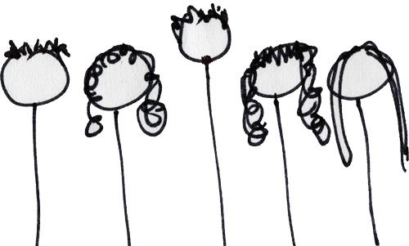
Five Types of Assets
Individuals–bring skills, knowledge, expertise, energy
Notes:
Kretzmann and McKnight went a step further to identify five main types of assets. It starts with individuals.
A neighborhood that is portrayed as resourceful will be more likely to draw upon the skills of local people to address issues and solve problems. Residents themselves will see possibilities and not just problems. Residents are co-producers of their own well-being.

Slide 6
Five Types of Assets
Associations–informal groups, “engine-room of people-powered change” (Cormac Russell, ABCD faculty member)
Resources of public, private and non-profit institutions
Notes:
Assets are also informal networks and coalitions such as parent groups or clubs, and formal institutions such as social service organizations or Habitat affiliates.

Slide 7
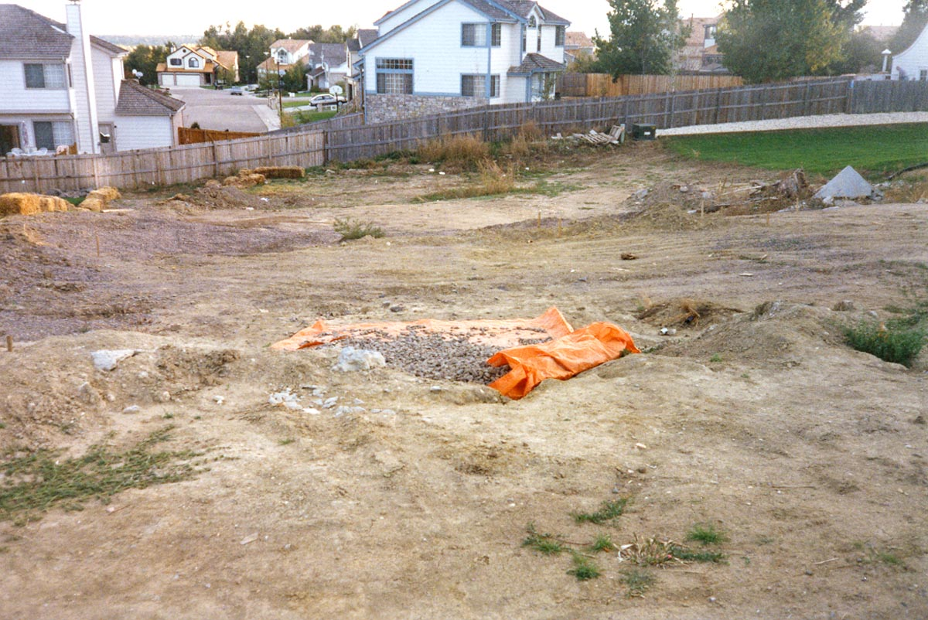
Five Types of Assets
Physical, infrastructure, and economic assets –land, buildings, common space, and purchasing power
Notes:
Assets also include physical spaces, such as churches, schools, and community parks, as well as the economic impact of local businesses and local purchasing power.

Slide 8
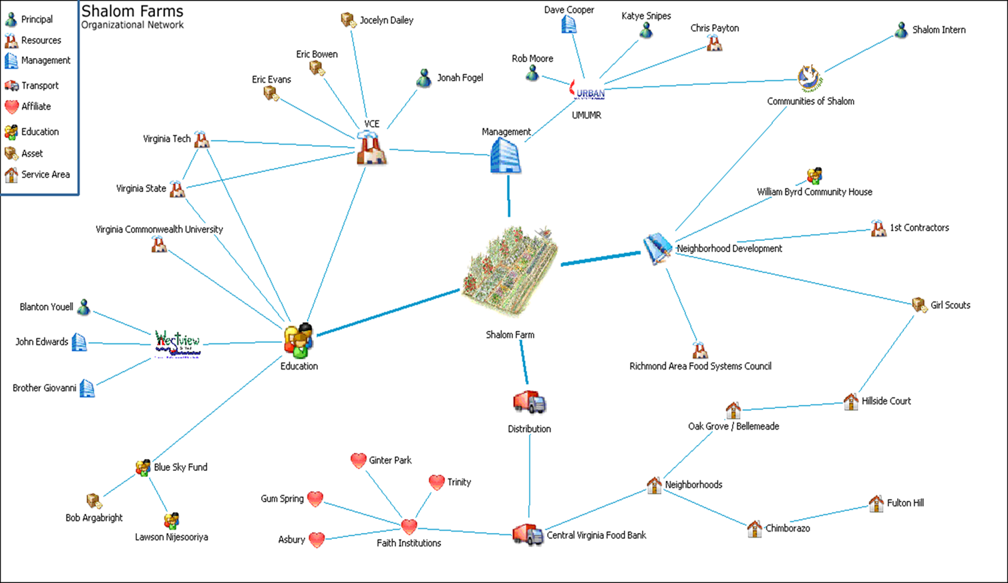
Five Types of Assets
Connections – a community’s stories, relationships, and its ability to work together
Notes:
Finally, there are assets in the ‘intangibles’ - the relationships and stories shared between people living in a community. Symbols may be used to visually describe a variety of these connections and associations. Depicted here is an example of neighborhoods, congregations, non-profits people, academic institutions and for profit businesses – all linked for a regional food security project.
As noted in the following slides, these assets focus on the gifts and strengths of a community, instead of its deficits or challenges. They are interrelated, building upon each other. Finally, they press leaders of institutions to think of their organization’s work in the wider context of what truly defines a community.

Slide 9
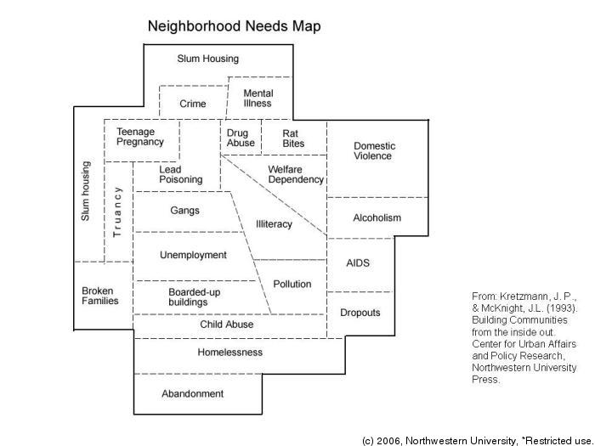
Neighborhood Needs: What’s Wrong
Notes:
This is a common view of deficit-based thinking. But what if we change the lens? What if we assume that everyone and every place, has gifts that help them shape their own future?

Slide 10
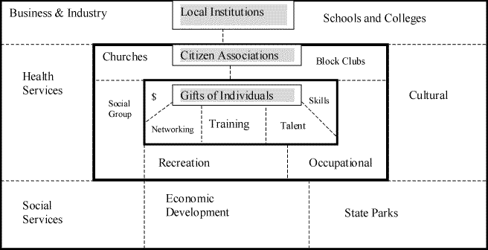
Neighborhood Assets: What’s Strong
Notes:
An asset-based approach first identifies the strengths of a community, using the five types of assets discussed earlier. You can see here that assets range from individuals, to citizen associations, to formal institutions, to physical and economic strengths, to the cultural connections within the community. You’ll also notice that gifts of individuals are in the center of this model, with other assets radiating out from the strengths of the people themselves.

Slide 11
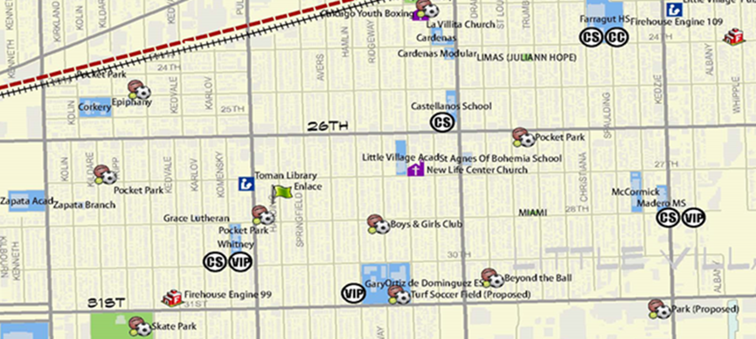
Neighborhood Assets: What’s Strong
Notes:
This is a visual depiction of an asset map – an inventory of all the types of gifts, strengths and assets of a community. As we’ll discuss later, developing an asset map of a focus neighborhood, and filling in specific examples within each of the asset categories previously described, is a foundational activity in implementing an ABCD approach.
Here’s an asset map from Google Earth and ESRI, two great platforms to map discovered resources. Another means is to computerize a Hybrid map using Visualyzer from Medlogix.

Slide 12
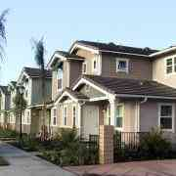
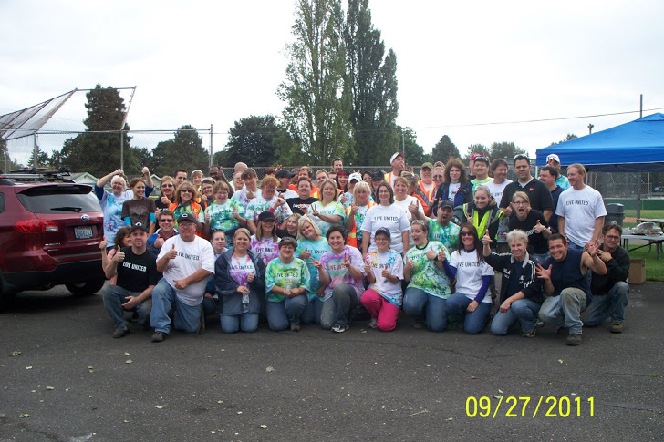
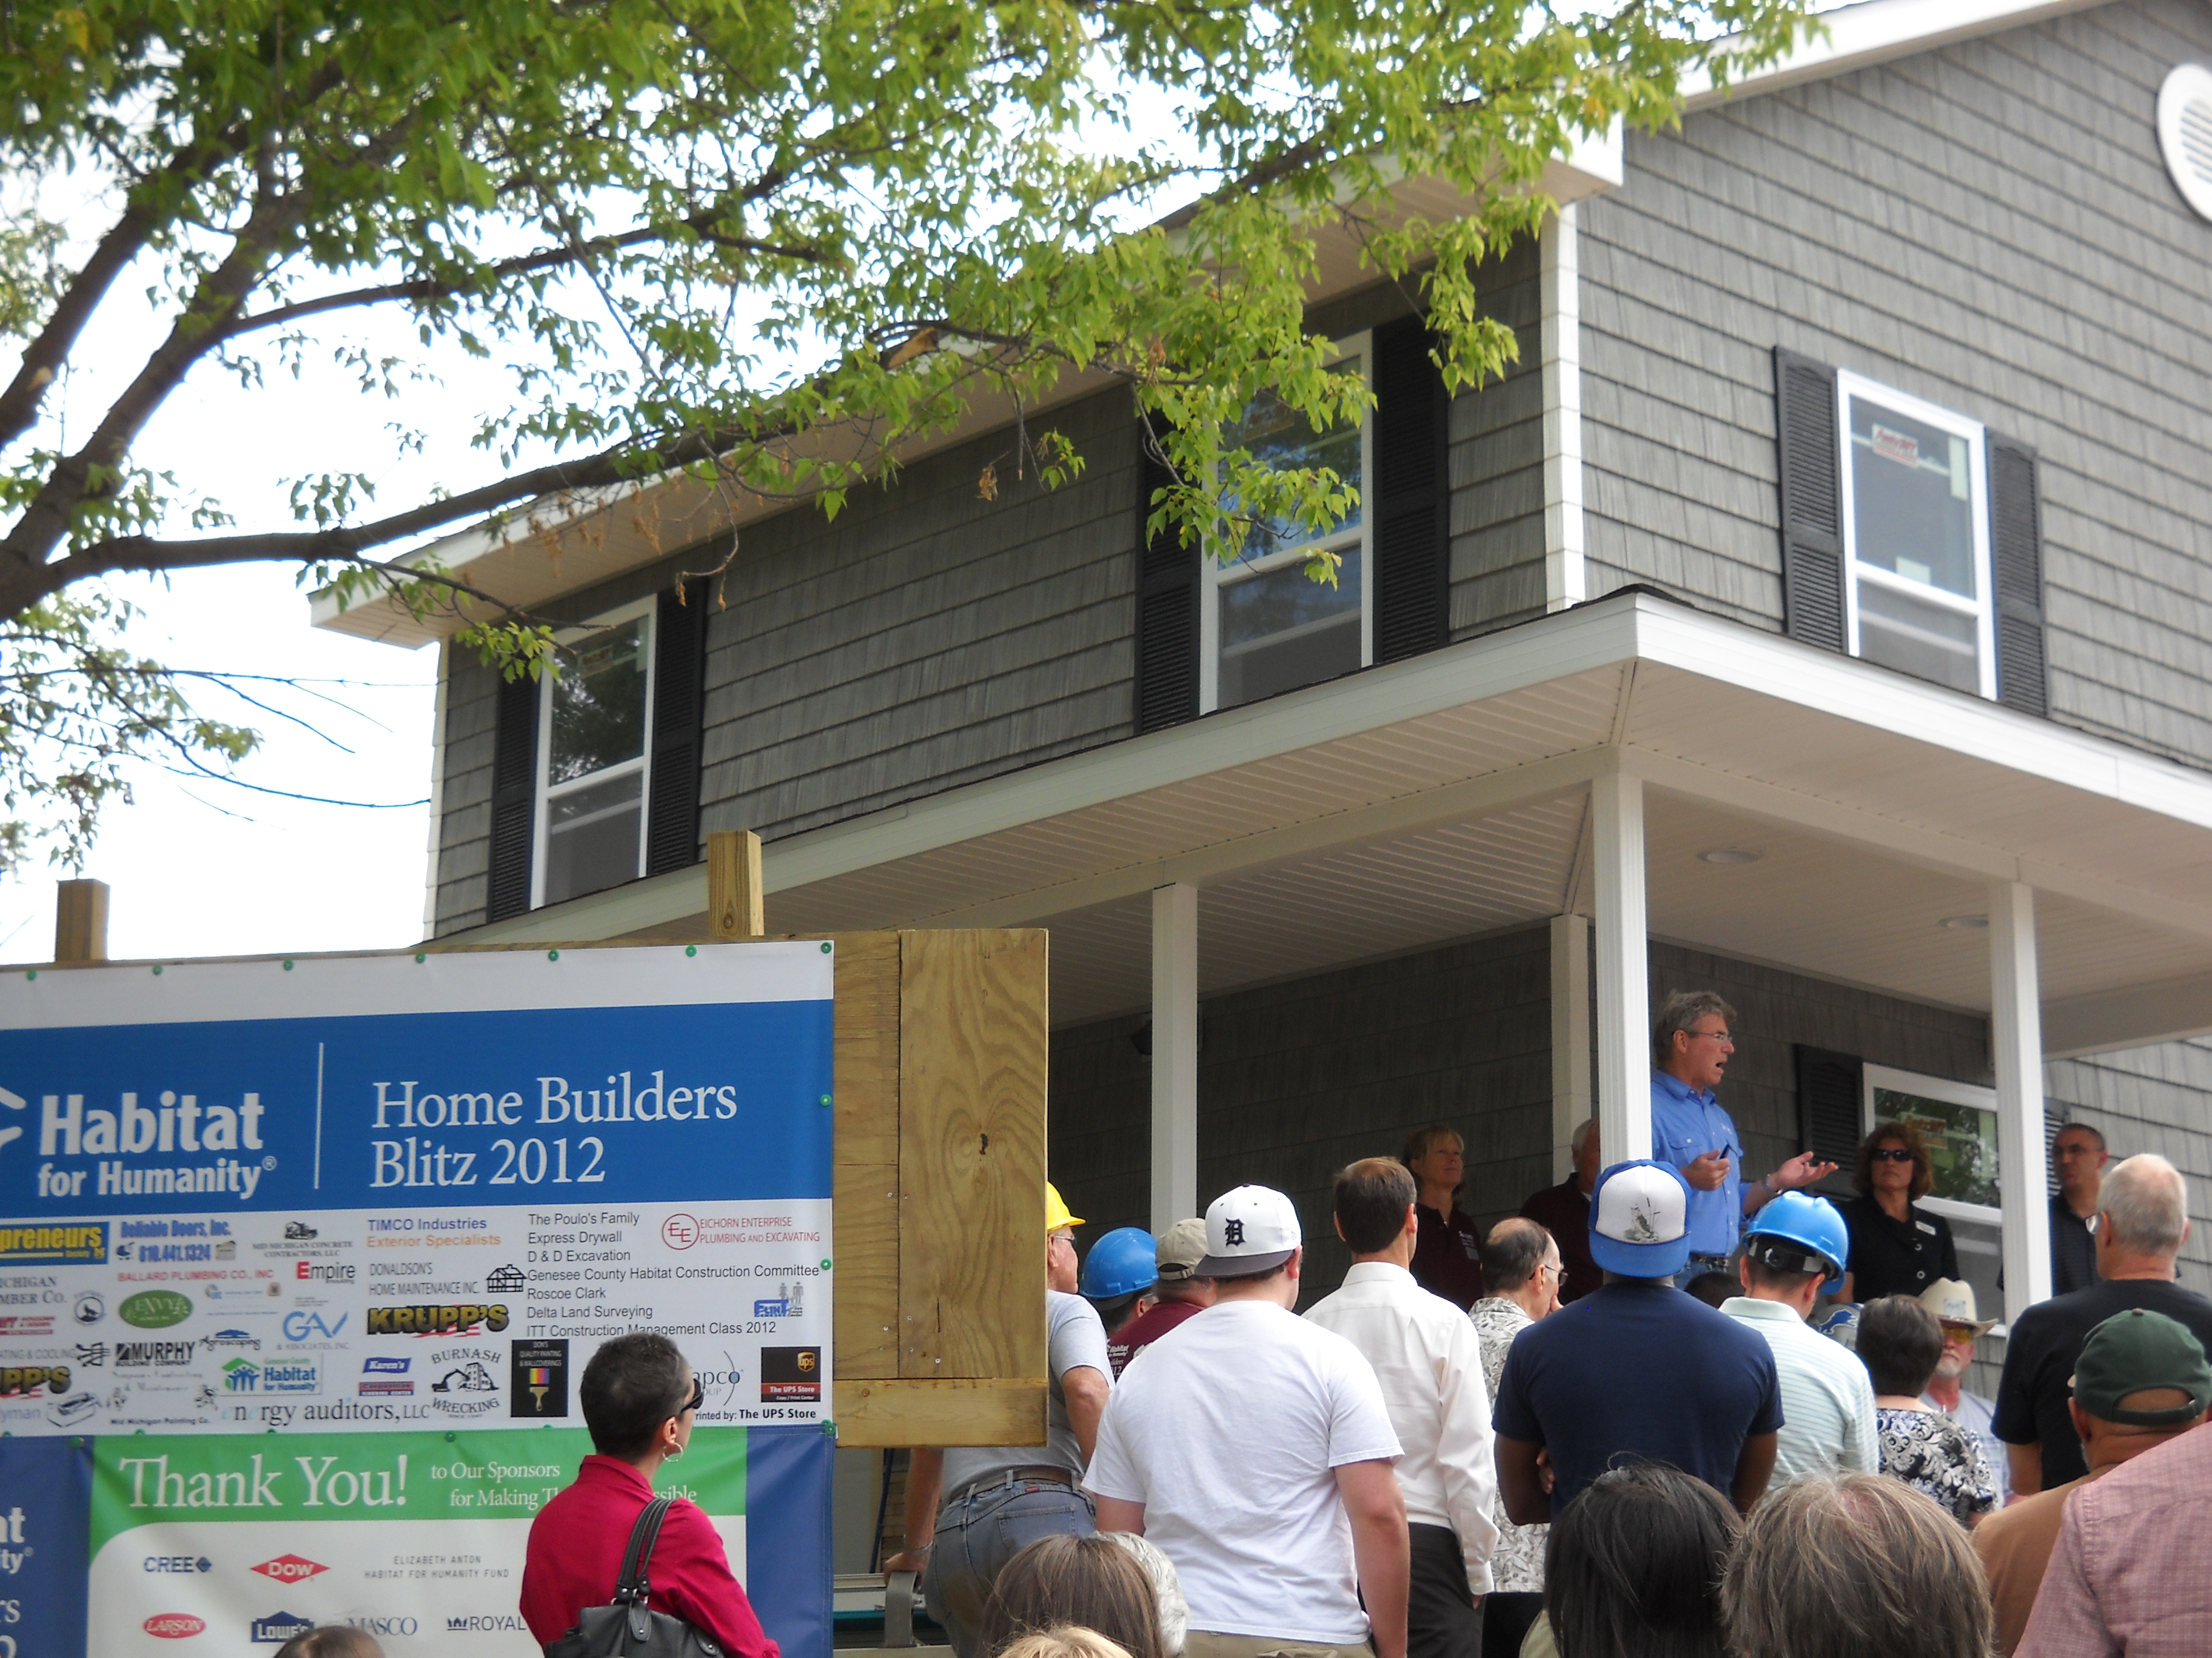

ABCD Examples
Notes:
Here are some examples of how asset-based community development can be put into practice by Habitat for Humanity and other community development corporations: [These pictures are timed, with a click at each example]
In Oxnard, California, low-income farmworker families who recently moved into an affordable rental development worked collectively with local business owners and city community development staff to jumpstart the installation of street lights to deter crime and vandalism in the neighborhood.
In Longview, Washington, local churches, residents, the local police, a local philanthropic organization and Cowlitz County Habitat for Humanity staff worked together to form a coalition to address safety and blight issues in a historic neighborhood. The community began an “Adopt A Block” initiative to improve the exterior of homes and two of the community’s leaders served on the Habitat affiliate’s board of directors and volunteer committees.
In Flint, Michigan, residents in the Grand Traverse neighborhood, neighboring downtown Flint, voiced their desire to address both the dilapidated vacant housing stock and the jumpstart the local economy during a long-range planning session of the neighborhood association. Genesee County Habitat for Humanity, who attended these meetings, saw an opportunity to create what became Habitat for Humanity International’s first live-work housing, as a small step to combine housing and economic development as key ingredients to neighborhood revitalization.
In Springfield, Ohio, a local university, a public policy and advocacy nonprofit, a community development corporation and parents and school leaders worked together with neighborhood residents to create a long-range plan to increase student achievement, increase parent involvement and improve the local housing stock in the neighborhood surrounding a local elementary school. The process included surveying households on their level of satisfaction living in the neighborhood and asked them to set priorities for how their neighborhood could be improved. The community development corporation is both building new homes and renovating the existing housing stock, focusing intentionally on specific streets in the community.

Slide 13


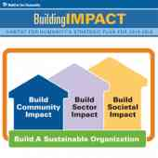
Value Proposition for ABCD
Notes:
Now for the ‘so what’ – what value does asset-based community development bring, over a needs-based approach?
[Click to show hand icon] First, there is a philosophical value-add to an asset-based approach over a needs-based one. Just as Habitat’s motto is “a hand up, not a hand out,” an asset-based approach does not assume that low-income people and communities are problems that need ‘fixing’. Instead, it flips this traditional social service model on its head, and sees people and communities as sources of their own solutions, with Habitat and other institutions as one piece of that puzzle.
[Click to show second icon] Second, there is an economic value that comes with an ABCD model. Just as the sweat equity approach helps offset the hard costs of construction, an asset-based approach to a Habitat’s work can result in increased in-kind donations of time, materials and other resources from individuals and partner organizations. In addition, by collaborating up front and responding to a community’s aspirations, there is an increased likelihood that neighbors and local leaders will see the value in the proposed development, and that people in positions of power greenlight a project rather than request costly changes or delay approvals.
[Click to show third icon] Finally, ABCD enables affiliates to better address Habitat’s 5-year strategic plan components of building community impact, building sector impact and building societal impact. Habitat alone can’t transform a neighborhood – while an a needs-based approach accentuates problems, an asset-based approach opens up the door for individuals and groups to collectively come together to generate solutions that can have lasting change.

Slide 14
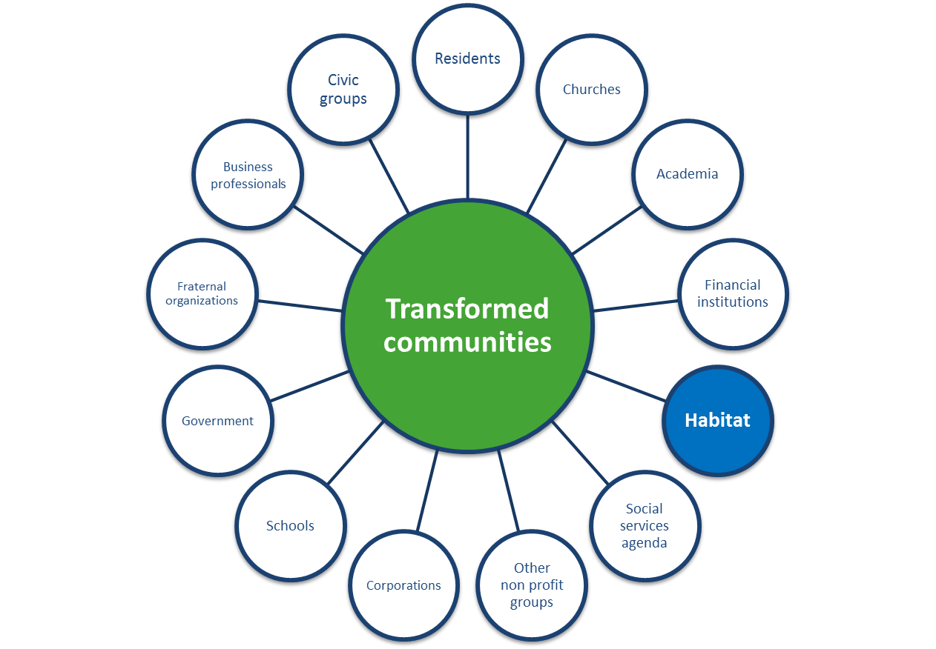
ABCD and Neighborhood Revitalization
NR aims to “serve more families by responding to community aspirations with an expanded array of products, services and partnerships, empowering residents to revive their neighborhoods and enhance their quality of life.”
Notes:
So, you may ask, how does asset-based community development relate to Neighborhood Revitalization? In short, the two are intertwined.
Neighborhood Revitalization is a holistic approach that expands Habitat’s traditional partnership with Habitat homeowners and volunteers. Launched in 2010, Habitat NR affiliates partner with neighbors and local organizations for a greater impact in transforming communities. Similar to ABCD’s focus on individuals at the epicenter of change, Neighborhood Revitalization starts at the grassroots level, with a first step to understand the dreams and goals of the people in the community. What do they believe will transform the neighborhood and enhance their quality of life?

Slide 15
NR Principles: We Will…
Work in a distinct, definable community.
Assume an asset-based approach to working with the community.
Adopt a humble, listening approach to the community.
Identify, respect and honor those who speak on behalf of the community.
Notes:
The eight principles that comprise Neighborhood Revitalization go hand-in-hand with the tenets of asset-based community development. Some, like principle #2, explicitly note an asset-based approach to work in a focus neighborhood, versus a deficit or needs-based approach. Others, such as principle #3, incorporate key characteristics of ABCD. Principle 3 recognizes ABCD’s emphasis on intentional listening, and asking, not telling. Principle 4 falls at the heart of ABCD – people have a voice, ideas, solutions, and resources that should be respected and valued.

Slide 16
NR Principles: We Will…
5. Recognize that housing is one component of a community development strategy.
6. Offer a range of housing products and services to contribute to the community’s aspirations.
7. Make a multiyear commitment to the community in which we agreed to work.
8. Commit to a process that holds the participants accountable to evaluating our work.
Notes:
Principles 5 and 6, and 7 acknowledge that community impact doesn’t begin or end with just affordable housing, nor is it likely that transformation is a quick-win. A range of products and services over a period of time, including but not limited to housing, will help transform communities. By first asking the community, ‘What does a transformed community look like for you?’, rather than telling a community ‘this is what you need,’ and then determining how Habitat can work alongside residents and other key partners to actualize that change, a Habitat affiliate is both practicing asset-based community development and Neighborhood Revitalization.

Slide 17
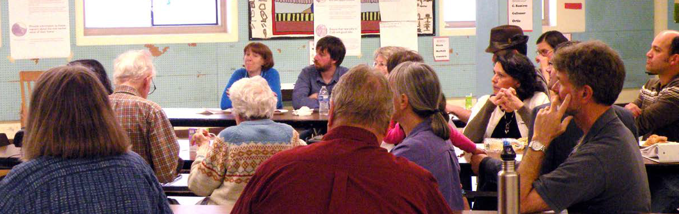
Aligning ABCD and Board Leadership
ABCD can, and should, be integrated across a Habitat Board’s work and practices
Notes:
We’ll now switch gears to the final part of our training, which brings ABCD into the Board room. [Click for picture]This section will offer suggestions on how Boards can incorporate ABCD into their work, as well as open-ended questions for Boards to consider once this training concludes.
Just as Neighborhood Revitalization is an essential element of Habitat’s work, so too should asset-based community development be an integral part of a Habitat affiliate’s operating principles and practices. The following slides will tackle this topic in four ways – via Board composition, a Board’s fiduciary responsibilities, a Board’s focus on setting strategic direction and monitoring progress toward goals, and at a 10,000 foot level – through the big-picture discussions a Board has about what its affiliate is setting out to do, and the impact it wants to have.

Slide 18
ABCD & Board Composition/Meeting Structure
Are focus neighborhood residents serving on our Board of Directors and/or on Committees?
Where do Board meetings take place? Is there an opportunity to hold a Board meeting at a meeting space in our focus neighborhood?
Do we hear directly from focus neighborhood residents on a regular basis?
Notes:
A key area of consideration for Boards is who is in the room to begin with, and even where the room is actually located. Incorporating ABCD into your Board’s work can begin with member recruitment. A clear way to ensure that the voices of residents and partners are front and center is by including those voices in leadership positions on the Board, and by providing time for meaningful discussions about neighborhood priorities at board meetings, with residents and other local leaders taking the lead role in shaping the agenda and discussion. Boards can also consider how to bring their meetings closer to the neighborhood itself – institutional partners such as schools, churches, and community centers are often extremely willing to open up their meeting spaces to partners.
Finally, visibly posting NR and ABCD constructs such as the five types of assets and the eight NR principles, just as many affiliates post their mission statements, is an overt way to keep ABCD front and center.

Slide 19
ABCD and a Board’s Fiduciary Role
How, and via what channels, is our commitment to ABCD incorporated in our budget?
Do residents have a voice in prioritizing where our affiliate’s time, money and energy is spent in this neighborhood?
How can we acknowledge and celebrate the value of the gifts and resources that neighborhood residents contribute to revitalizing their community?
Notes:
Approving annual budgets, authorizing and approving annual audits, monitoring financial performance, and serving as fiduciary agents are some of the most important functions a Board has. Typically, annual budgets are organized by major business lines, and are drafted by senior managers to reflect the organization’s programmatic priorities.
The questions on this slide offer up some new ways a Board can consider its fiduciary role – ways that overlay with both Neighborhood Revitalization and asset-based community development. For example, an affiliate’s fiscal director could create a program budget that outlines the percentage of different staff members’ time that is allocated to work in the affiliate's focus neighborhood – time that may focus more on listening to residents and working with stakeholders to co-create a vision for an improved community, and less on the actual bricks and mortar results. Taking a step back, a Board could also ask itself, are we spending our money in this neighborhood in a way that aligns with the community’s interest? And, how are we documenting our multi-year commitment to this neighborhood in both this year’s budget, and future financial projections?
Finally, just as sweat equity has a monetary value, so do the contributions of other types of skills, expertise and time by residents and other partners. A Board that practices ABCD both appreciates these contributions and incorporates them into their fiscal thought process.

Slide 20
ABCD and a Board’s Strategic Role
What is our long-range vision for our work in our focus neighborhood? Who are we working with to make this vision a reality?
How are we incorporating community aspirations and neighborhood resources into our long-range plans?
To what degree are residents leading revitalization efforts in our target neighborhood?
Notes:
Another vital function of a Board is setting strategic direction, and then monitoring progress toward reaching that strategic direction. ABCD plays heavily into this component of a Board’s work, with this slide offering just a few of the many questions a Board can ask itself as it plans for the future. At the heart of these questions is the community-driven approach espoused by ABCD. Is Habitat an active member of a collective collaborative solution, and do its long-range plans echo that collaborative, community-driven approach? An asset mapping project, where Habitat and others identify the key players across each of the asset categories, can document who could take part in a collaborative solution.
We also call your attention to the 8th Neighborhood Revitalization principle – “committing to a process that holds the participants accountable to evaluating our work.” ABCD is not only about involving residents in establishing a vision for change and working alongside others like Habitat to achieve that change, but also about evaluating to what degree Habitat and others are actualizing those goals. Participatory evaluation processes such as Success Measures provide opportunities for Habitat affiliates to engage community members in setting a baseline for change, and then measuring progress against that baseline over time.

Slide 21
ABCD at the 10,000 Foot Level
What is our role in contributing to our focus neighborhood’s health? What are others’ roles?
What words do we use to describe our work? Are they needs-based, or asset-based?
How can we become the kind of organization that others identify as an asset?
Notes:
Finally, we encourage boards to take a step back from their regular meeting agendas, and even their regular planning processes, to think more broadly about Habitat’s role in creating lasting changes in communities. Discussing these and other big-picture questions may require additional time and an intentional effort to think differently about our work, and even the language we use to describe our role.
Think to yourself – what is the story you want to be able to tell in 5, 10, or 20 years about how your focus neighborhood changed for the better? Who was involved in that change effort? What will have been accomplished? Answers to these questions will deepen your affiliate’s understanding and use of ABCD principles.

Slide 22
Summary and Closing Thoughts
Success in ABCD:
  Is a relationship-driven process; it takes time
  Needs to be a habit, not a “one-off” activity
  Requires introspection, intentional discussion, and a commitment to revisit organizational norms
  Focuses on listening and asking, not telling
Notes:
With success comes: trust between Habitat and the community, long-term alignment between Habitat and a community’s aspirations, and a higher likelihood that an affiliate’s mission will be met.
In closing, success in asset-based community development requires a lot of asking, listening, and intentional reflection on traditional ways that most institutions operate. It requires a deeper role in a neighborhood than bricks and mortar. And yet, when successful…
The results will create lasting positive change: for neighborhood residents, for associations and institutional partners, and for Habitat itself. This includes not just new homes and rehabilitated buildings, but a stronger community fabric.

Slide 23
Resources
The Asset-Based Community Development Institute: www.abcdinstitute.org
Building Communities from the Inside Out: A Path Toward Finding and Mobilizing a Community's Assets, Kretzmann and McKnight, 1993
Lecture from Cormac Russell, ABCD faculty: https://www.youtube.com/watch?v=ejH9tPsgN_E
My.Habitat.org:
  HFH Affiliate Rationale for ABCD Approach
  ABCD Principles and Practices webinar
Notes:
This webinar just touches the surface on ABCD, but luckily there are dozens of publicly available videos, pamphlets, toolkits and examples of key concepts such as asset-mapping and strengths-based approaches toward community development that can be found on the Asset-Based Community Development Institute website. For those who want to learn more, the seminal work on this topic, Kretzmann and McKnight’s Building Communities from the Inside Out is a must-read.
MyHabitat.org also offers several training tools and supportive materials on both ABCD and Neighborhood Revitalization. Two documents of high relevance are a memo outlining the rationale for an ABCD approach and a more detailed webinar series about ABCD.

Slide 24
Thank You!
24
Notes:
Finally, to help jumpstart conversation, we also offer a worksheet as part of this webinar training, which provides short scenario and discussion questions linked to implementation of ABCD principles and practices.
Thank you very much for taking the time to actively listen to this webinar and for your leadership as a Habitat affiliate Board member. We hope this is just the beginning, and we encourage you to continue the dialogue about asset-based community development – with individuals, with institutional partners, with the Habitat staff and volunteers, and other stakeholders.

